Slide 1
8051 - SERIAL PORT

Slide 2
Prerequisite
Contrast and compare serial versus parallel communication
List the advantages of serial communication over parallel
Explain serial communication protocol
Contrast synchronous versus asynchronous communication
Contrast half-versus full-duplex transmission
Explain the process of data framing
Describe data transfer rate and bps rate

Slide 3
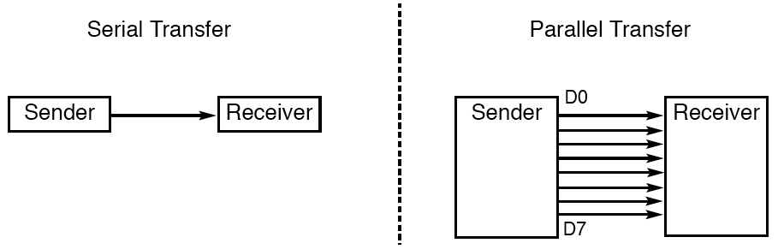
BASICS OF SERIAL COMMUNICATION
Computer transfers data in two ways.
byte of data must be converted to serial bits using a
parallel-in-serial-out shift register and transmitted over a single data line
receiving end there must be a serial-in-parallel-out shift register.
2 methods, asynchronous and synchronous
synchronous method transfers a block of data at a time
asynchronous method transfers a single byte at a time

Slide 4
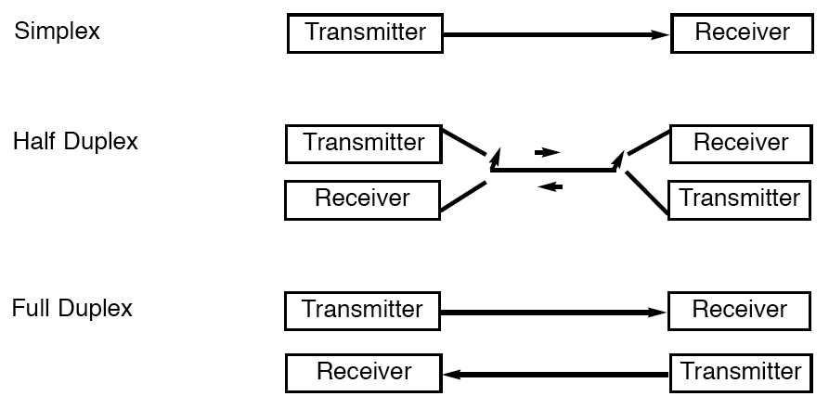
BASICS OF SERIAL COMMUNICATION
Simplex, Half-, and Full-Duplex Transfers

Slide 5
BASICS OF SERIAL COMMUNICATION
Uses special IC chips called
UART (Universal Asynchronous Receiver Transmitter) and
USART (Universal Synchronous Asynchronous Receiver-Transmitter)
8051 chip has a built-in UART

Slide 6

Introduction to Serial Communication cont’d..
For asynchronous transmission, each data character has
a bit to identify its start &
1 or 2 bits to identify its end.
in modern PCs one stop bit is standard
Here each character is identified individually
Thus characters can be sent at any time in the same way it is transmitted.
The reception and transmission are not synchronized.
START bit is always LOW
STOP bits are always HIGH
Asynchronous Serial Data Transfer Bit Format- Frame

Slide 7
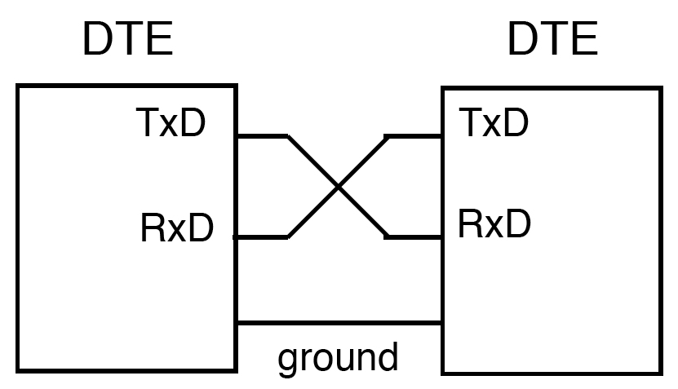
BASICS OF SERIAL COMMUNICATION
DTE (data terminal equipment)
DCE (data communication equipment)
DTE - terminals and computers that send and receive data
DCE - communication equipment responsible for transferring the data
simplest connection between a PC and microcontroller requires a
minimum of three pins, TxD, RxD, and ground

Slide 8
RxD and TxD pins in the 8051
8051 has two pins used for transferring and receiving data serially
TxD and RxD are part of the port 3 group
pin 11 (P3.1) is assigned to TxD
pin 10 (P3.0) is designated as RxD
these pins are TTL compatible

Slide 9
8051 SERIAL PORT PROGRAMMING IN ASSEMBLY
Baud rate in the 8051
baud rate in the 8051 is programmable
done with the help of Timer 1; Here Timer1 sets the Baud Rate.
relationship between the crystal frequency and the baud rate in the 8051
8051 divides the crystal frequency by 12 to get the machine cycle frequency

Slide 10
XTAL = 11.0592 MHz, machine cycle freq is 921.6 kHz
8051's UART divides the machine cycle freq by 32 ; once more before it is used by Timer 1; to set the baud rate
921.6 kHz divided by 32 gives 28,800 Hz
Timer 1 must be programmed in mode 2, that is 8-bit, auto-reload

Slide 12
Example With XTAL = 11.0592 MHz, find the TH1 value needed to have the following baud rates. (a) 9600 (b) 2400 (c) 1200
machine cycle frequency
= 11.0592 MHz / 12 = 921.6 kHz
Timer 1 frequency provided by 8051 UART
= 921.6 kHz / 32 = 28,800 Hz
(a) 28,800 / 3 = 9600 where -3 = FD (hex)
(b) 28,800 / 12 = 2400 where -12 = F4 (hex)
(c) 28,800 / 24 = 1200 where -24 = E8 (hex)

Slide 13
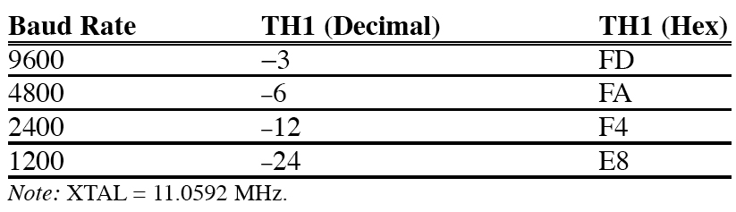
8051 SERIAL PORT
Table Timer 1 : TH1 Register Values for Various Baud Rates

Slide 14
SBUF: 8051 SERIAL PORT

Slide 15
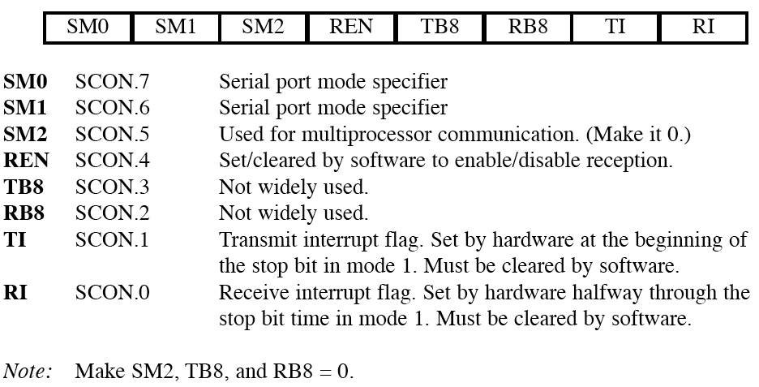
SCON : 8051 SERIAL PORT
SCON (serial control) register
to program the start bit, stop bit, and data bits
SCON Serial Port Control Register (Bit-Addressable)

Slide 16
Serial port -Modes

Slide 17
SCON : 8051 SERIAL PORT
SM0 and SM1 determine the mode
only mode 1 is important
when mode 1 is chosen, the data framing is 8 bits, 1 stop bit, and 1 start bit
compatible with the COM port of PCs
mode 1 allows the baud rate to be variable and is set by Timer 1 of the 8051
for each character a total of 10 bits are transferred, where the first bit is the start bit, followed by 8 bits of data, and finally 1 stop bit.

Slide 18
Baud Rates in serial port in various modes

Slide 19
Serial Data Mode 0— Shift Register Mode
Mode 0, selected by writing 0s into bits SM1 and SM0 of SCON,
puts the serial port into 8-bit shift register mode.
Serial data enter and exit through RXD, and
TXD outputs the shift clock.
Eight bits are transmitted or received with the LSB first.
The baud rate is fixed at 1/12th the on-chip oscillator frequency.
The terms "RXD" and "TXD" are misleading in this mode.
The RXD line is used for both data input and output, and the TXD line serves as the clock.

Slide 20
Serial Data Mode 1— Standard UART
Supports Full Duplex Serial communication.
SBUF becomes a 10-bit full-duplex receiver/ transmitter that may receive and transmit data at the same time.
Pin RXD receives all data, and pin TXD transmits all data.
Transmitted data is sent as a start bit, eight data bits (LSB, first), and a stop bit.
Interrupt flag TI is set , once all 10 bits have been sent.
Received data is obtained in the same order.
Data bits are shifted into the receiver at the programmed baud rate,
The data word will be loaded to SBUF if the following conditions are true:
RI must be 0,
mode bit SM2 is 0
The stop bit is 1 (the normal state of stop bits).

Slide 21
Serial Data Mode 1— Standard UART
Of the original 10- bits, the start bit is discarded,
The 8- data bits go to SBUF,
The stop bit is saved in bit RB8 of SCON.
RI is set to 1, indicating a new data byte has been received.
If RI is found to be set at the end of the reception, indicating that the previously received data byte has not been read by the program, or if the other conditions listed are not true, the new data will not be loaded and will be lost.
RI set to 0; implies that the program has read the previous data byte and is ready to receive the next; a normal stop bit will then complete the transfer of data to SBUF regardless of the state of SM2.

Slide 22
Mode 1 : Baud Rates

Slide 23
SCON : 8051 SERIAL PORT
REN (Receive ENable)
REN=1, allows 8051 to receive data on the RxD
if 8051 is to both transfer and receive data, REN must be set to 1
REN=0, the receiver is disabled
SETB SCON.4 and
CLR SCON.4,

Slide 24
SCON : 8051 SERIAL PORT
TI (transmit interrupt)
when 8051 finishes the transfer of the 8-bit character, it raises the TI flag to indicate that it is ready to transfer another byte
RI (receive interrupt)
when the 8051 receives data serially via RxD, it places the byte in the SBUF register
then raises the RI flag bit to indicate that a byte has been received and should be picked up before it is lost

Slide 25

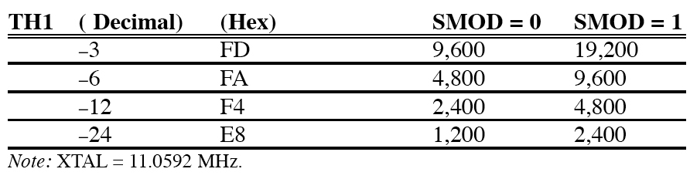
PCON : 8051 SERIAL PORT
Doubling the baud rate in the 8051
two ways to increase the baud rate
Use a higher-frequency crystal
Change a bit in the PCON register
Baud Rate Comparison for SMOD = 0 and SMOD = 1

